Slide 1
Trustworthy Credit Scoring: A Merkle Tree based Blockchain Enhanced Approach
Monirul Islam Mahmud
Shivam Patel

Slide 2
Credit Score
A credit score is a numerical expression based on credit analysis that represents a person's creditworthiness.
Scores typically range from 300 to 850, with higher scores indicating lower credit risk.
Calculated using payment history, credit utilization, length of credit history, types of credit card used, and recent inquiries.
Used by financial institutions to evaluate loan applications, set credit limits, and interest rates.

Slide 3
Motivation
Why Secure, Interpretable Credit Scoring Matters
Bias & Opacity: Traditional credit scoring models are often "black-box" and prone to bias against credit-invisible populations (Hurley & Adebayo, 2016).
Security Concerns: Credit data breaches are frequent; tampering with sensitive financial data can have severe consequences (Ponemon Institute, 2022).
Explainability: Lenders and regulators now demand interpretable AI models for fair and accountable decision-making (Rudin, 2019).
Blockchain: Provides tamper-proof, decentralized data storage ensuring integrity in sensitive applications like credit scoring (Zheng et al., 2018).
Social Inclusion: Unlocking credit access for underserved communities using secure and fair systems.

Slide 4
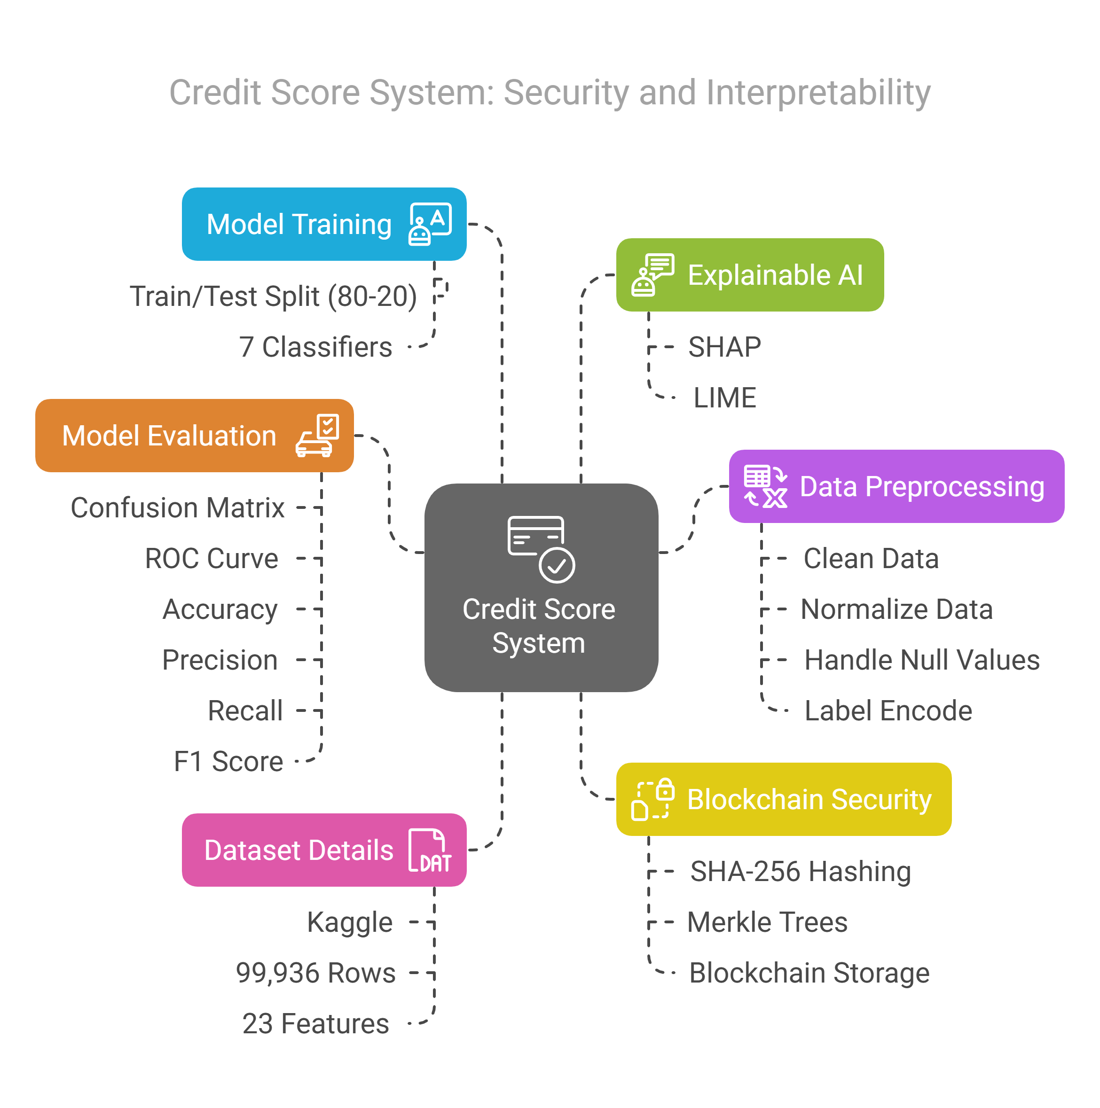
Methodology
This project combines Explainable AI (XAI) and Blockchain to develop a secure and transparent credit scoring system.
Dataset: Kaggle Credit Score dataset
ML Models: 7 classifiers
Explainability via SHAP & LIME
Merkle Tree Blockchain for integrity

Slide 5
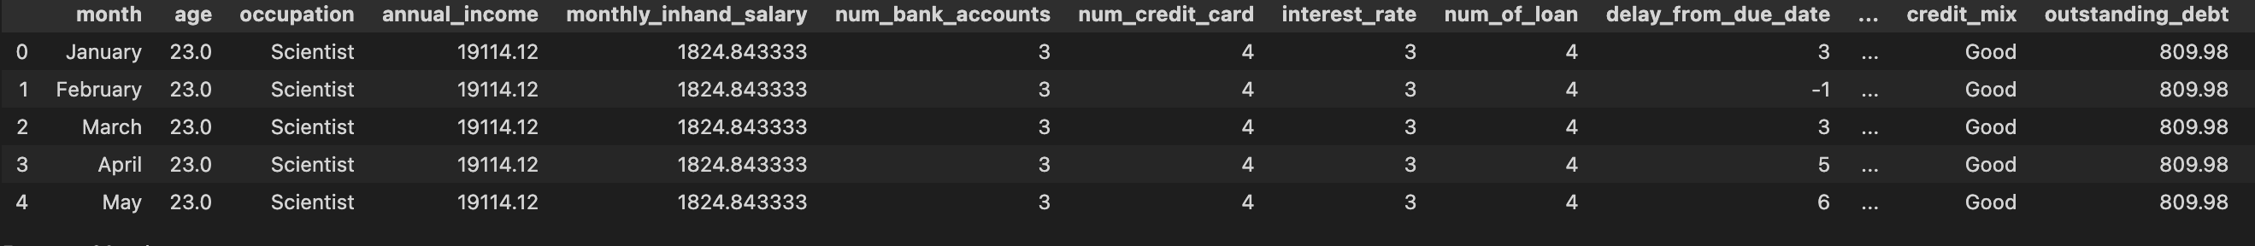
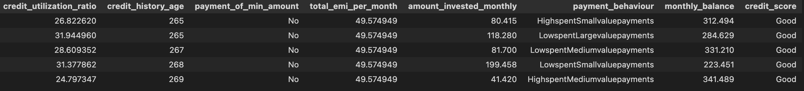
Dataset Details
From Kaggle - https://www.kaggle.com/datasets/nazmclk/cleaned-credit-score-dataset
99,936 rows and 23 Columns.

Slide 6
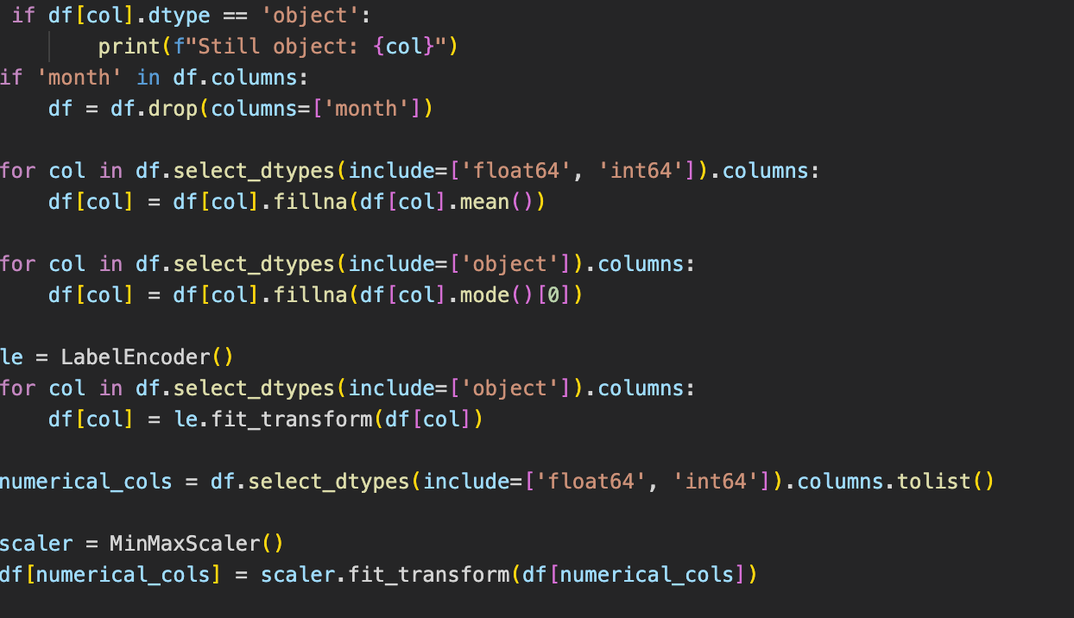
Data Preprocessing
1. Load and clean dataset
2. Apply label encoding
3. Handle missing values
4. Address class imbalance using SMOTE
5. Normalize features using MinMaxScaler

Slide 7
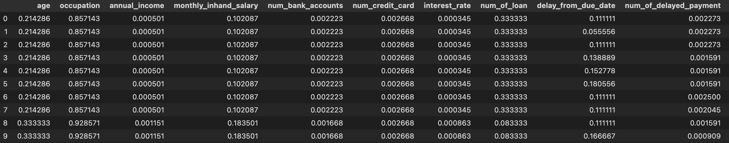
After Preprocessing
Before Preprocessing

Slide 8
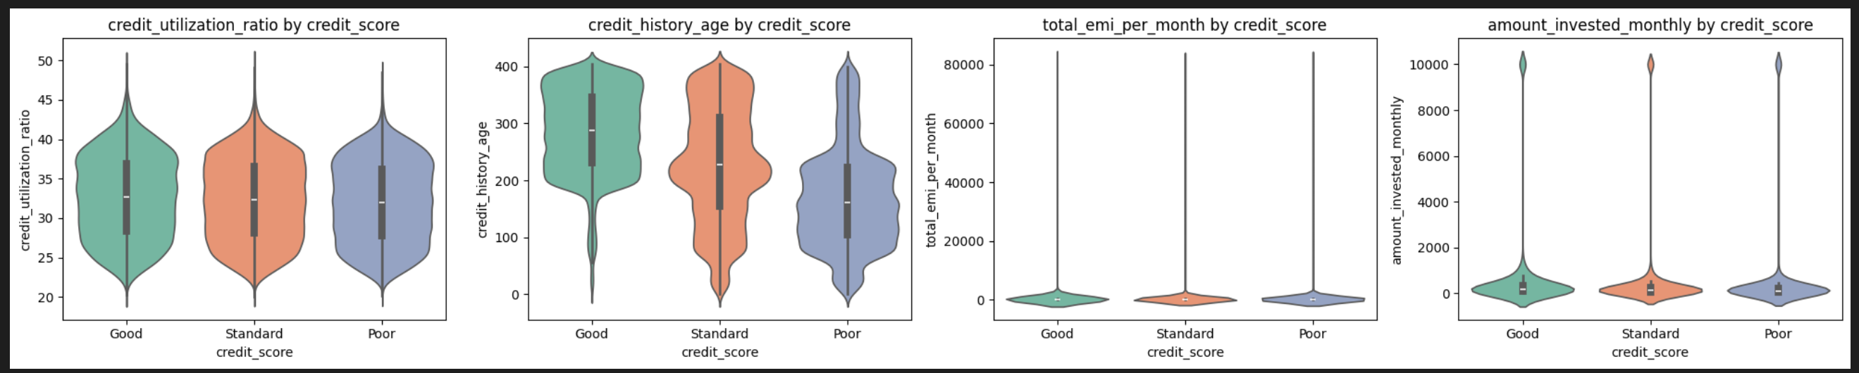
Data Analysis (Violin Plot)
Visualize the distribution of numerical features across different credit score categories (e.g., Good, Standard, Poor).
Visualizes the full distribution and density of numerical features across target class.

Slide 9
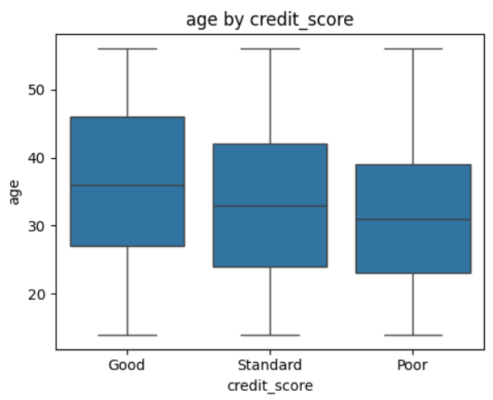
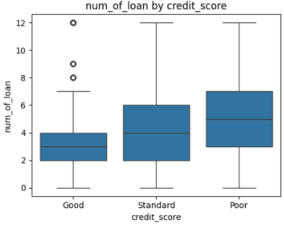
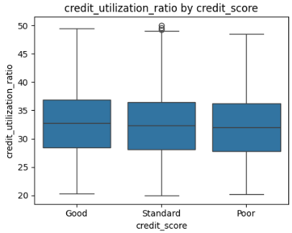
Data Analysis (Box Plot)
Summarizes distribution, median, quartiles, and outliers of numerical features.
Effective for spotting feature-wise variability and detecting potential anomalies.

Slide 10
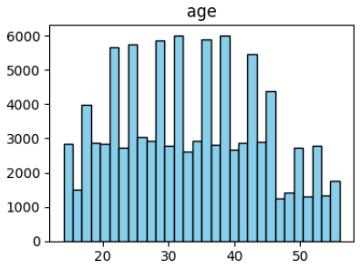
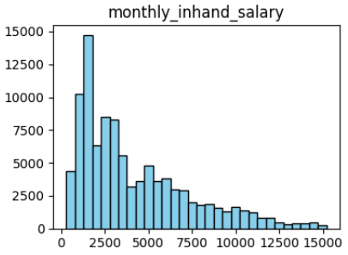
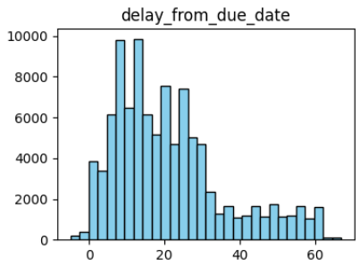
Data Analysis (Bar Plot)
Shows categorical feature frequencies or aggregated statistics (e.g., class counts, feature means).
Useful for understanding class imbalance and dominant values in numerical variables.

Slide 11
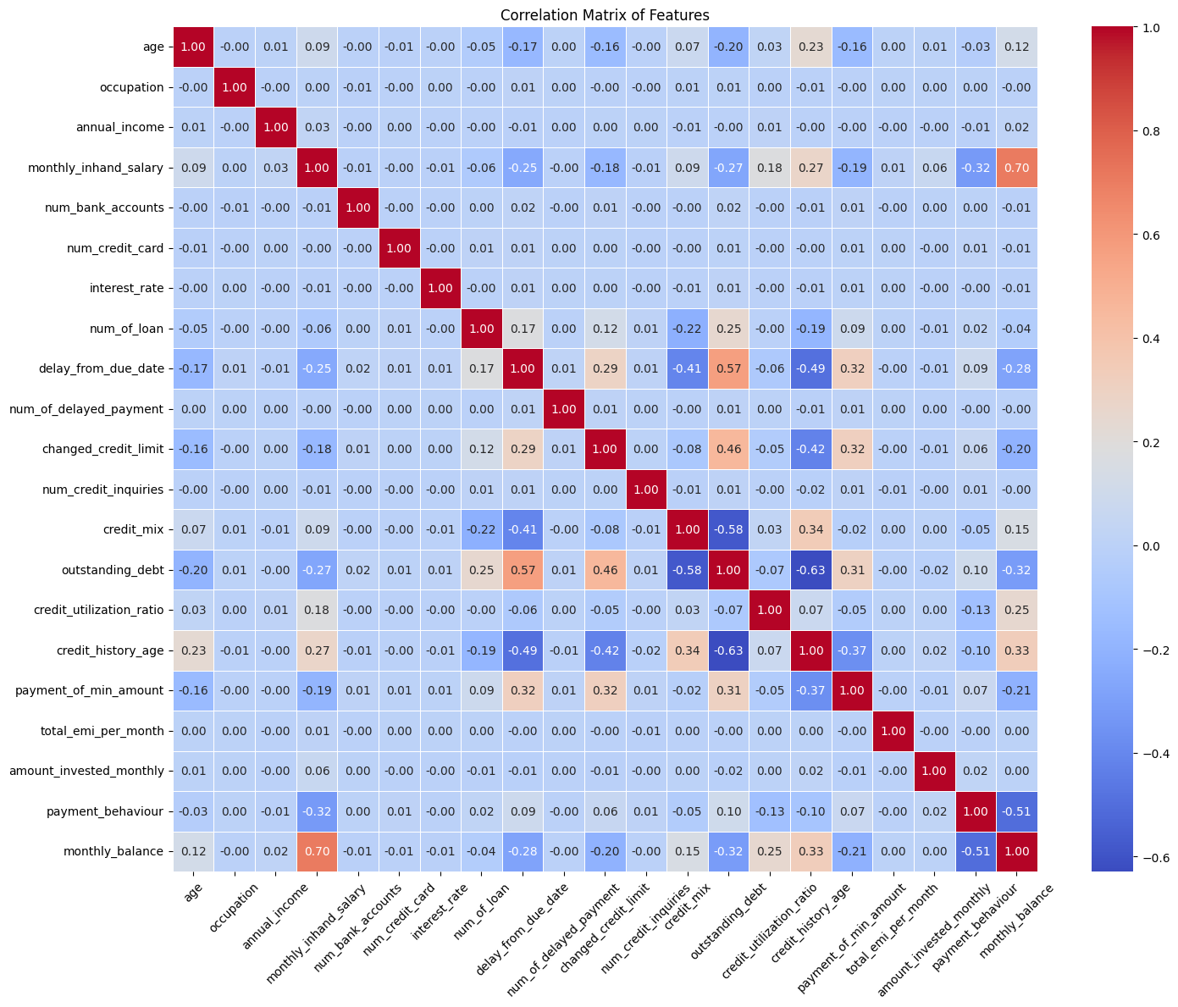
Correlation Matrix

Slide 12
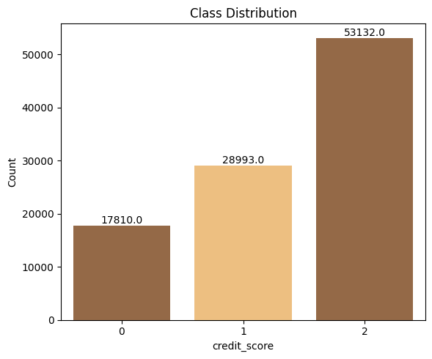
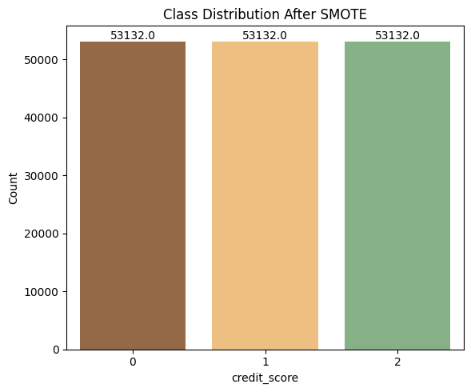
Handle Class Imbalance
Before SMOTE
After SMOTE
Issue: Class imbalance (fewer Poor, Good instances)
Solution: SMOTE applied to oversample the minority class by generating synthetic samples.
Impact: Enhanced model performance for Credit Score detection.

Slide 13
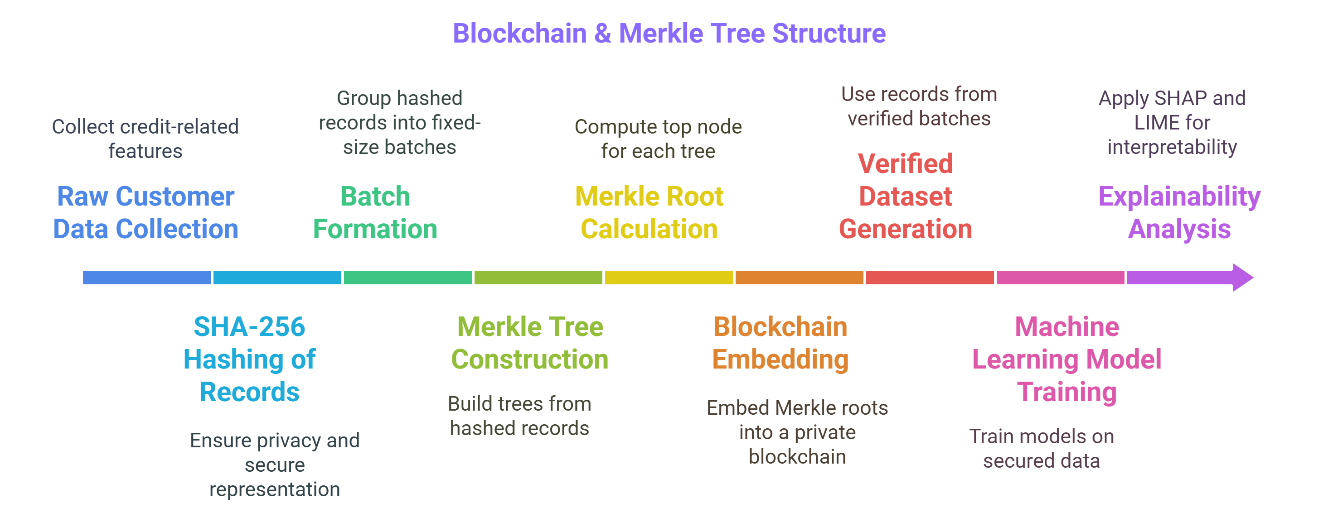
Blockchain with Merkle Tree
SHA-256 Hashing - Each record is hashed to ensure privacy and fixed-length security.
Builds a Merkle tree from the 10 hashed records for secure data representation.
Groups 10 records into a single batch for efficient processing.
The root of the Merkle tree represents the entire batch, reducing data size.
Merkle root allows fast, scalable verification of data integrity in the blockchain.

Slide 14
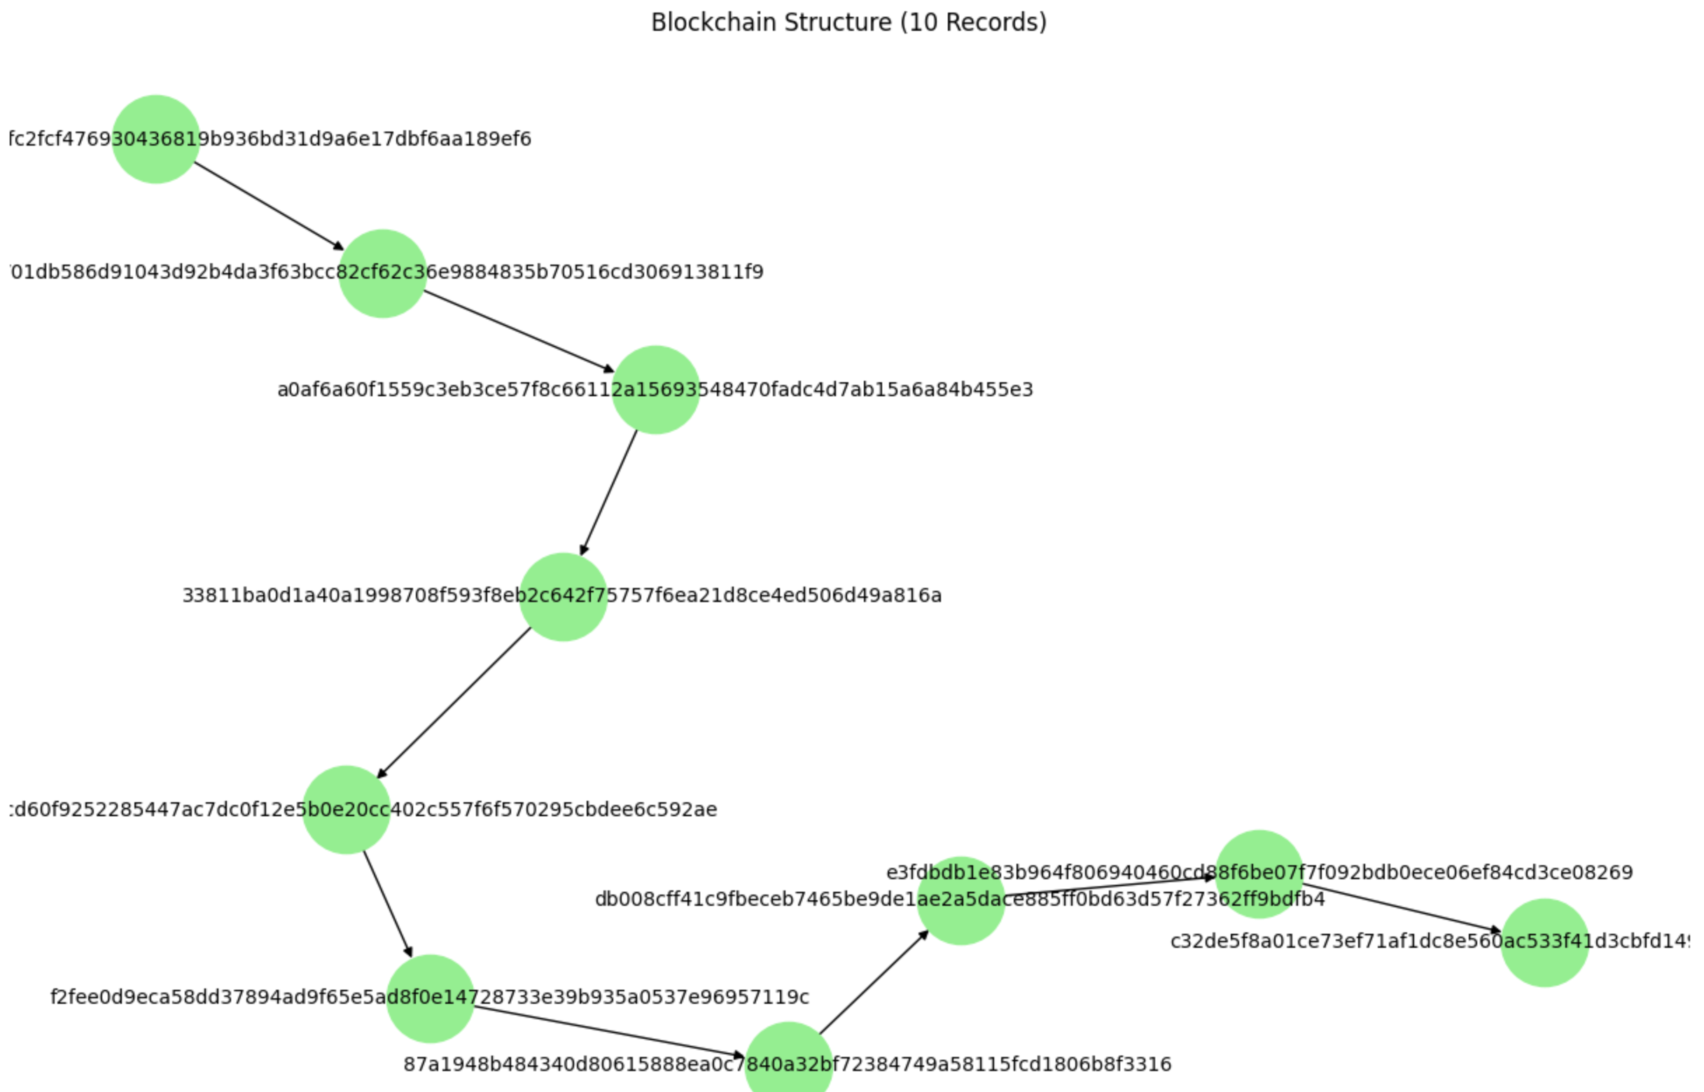
Blockchain Structure (10 Records)

Slide 15
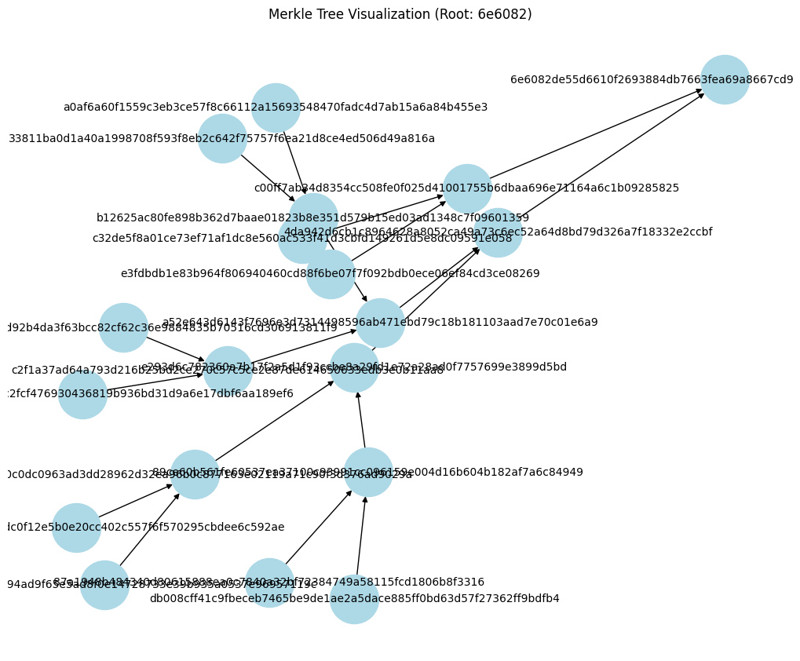
Merkle Tree Structure (10 Batch Size)

Slide 16
Applying ML models
We Apply ML Models To:
Predict a user’s creditworthiness (Good, Standard, Poor)
Extract meaningful patterns from the features (e.g., past payments, bill amounts)
Automate and scale the credit scoring process
Models used- Random Forest, Decision Tree, Logistic Regression, XGBoost ,SVM , KNN , ANN & Naive Bayes

Slide 17
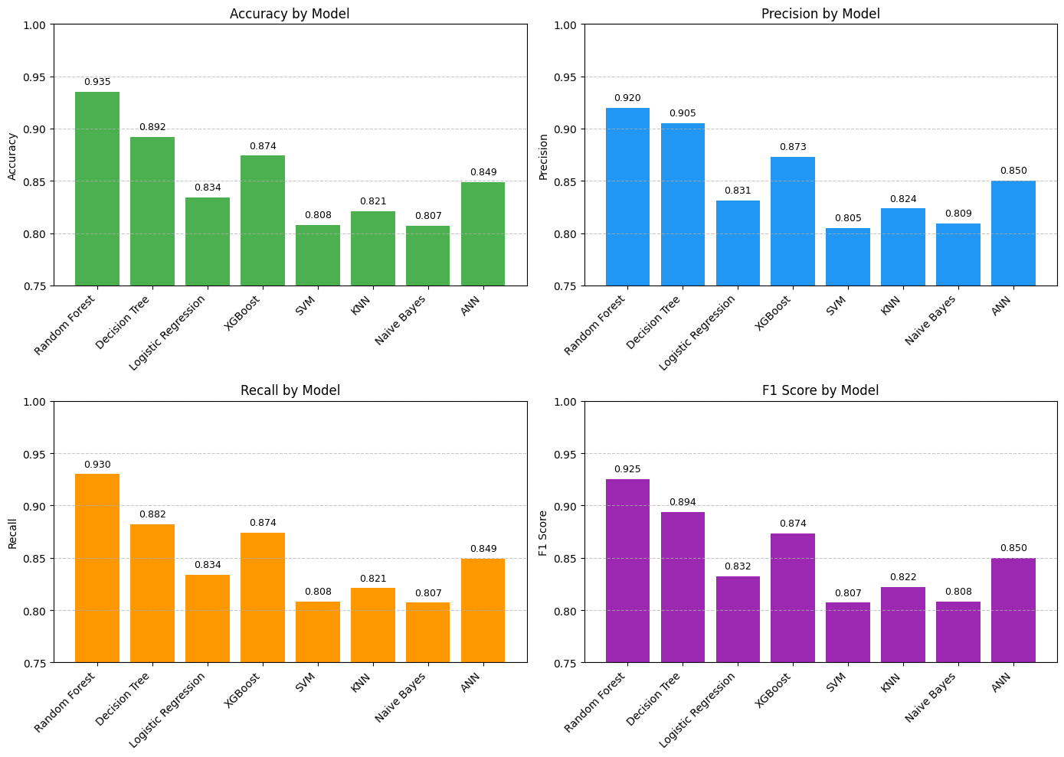
Model Performance Comparison

Slide 18
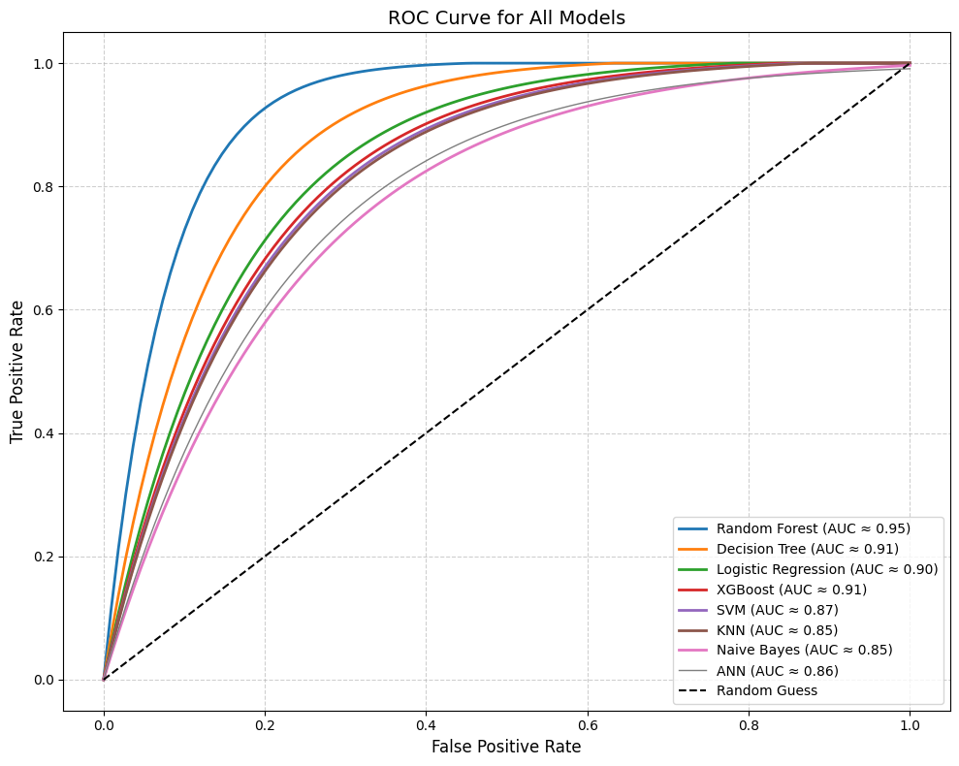
ROC Curve

Slide 19
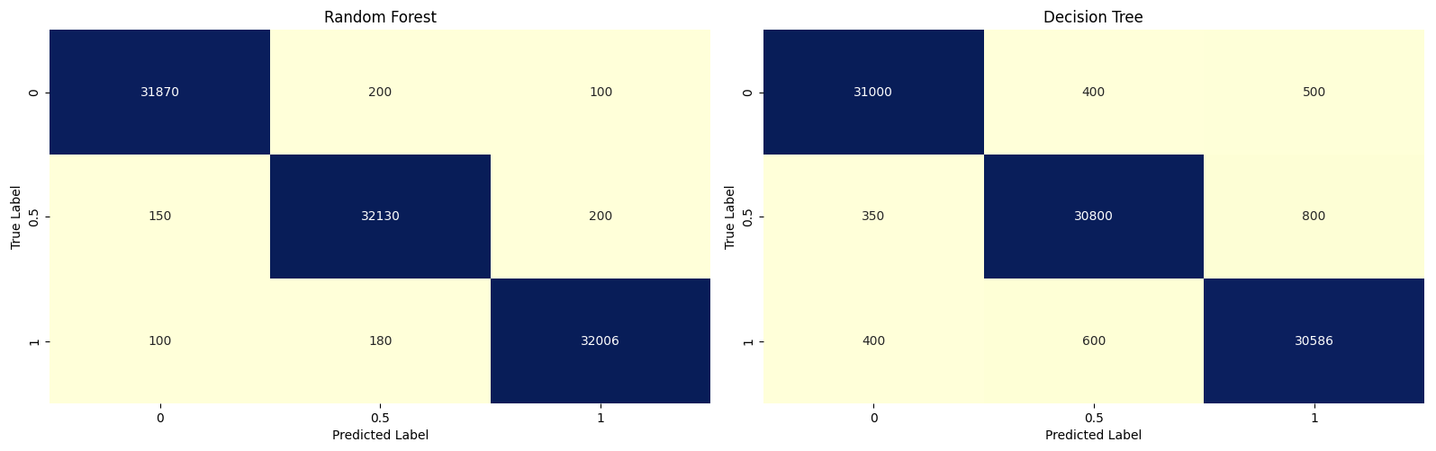
Confusion Matrix

Slide 20
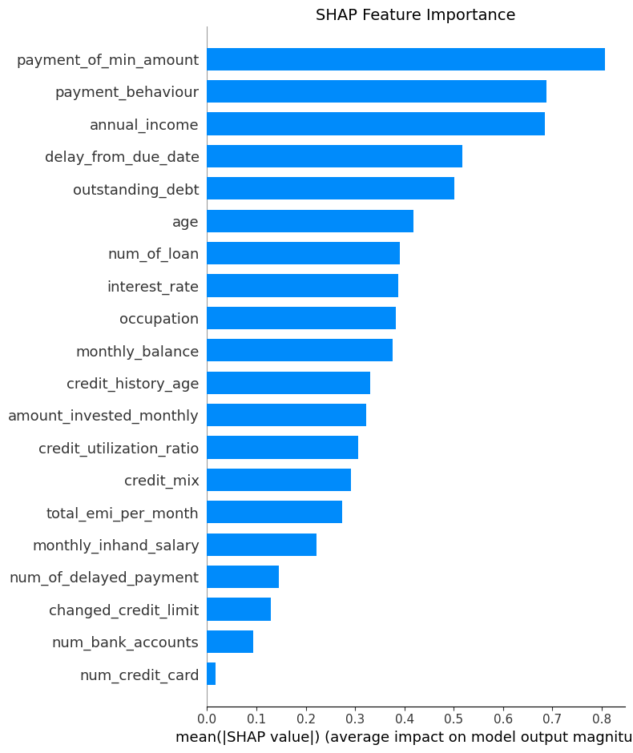
Explainable AI (SHAP)
1. Payment of Minimum Amount: Most impactful feature—customers making only minimum payments strongly influence credit score predictions.
2. Payment Behavior: Overall payment patterns (on-time vs. late) are the second biggest driver of model output.
3. Annual Income: Higher or lower income levels rank as the third most influential factor globally.

Slide 21
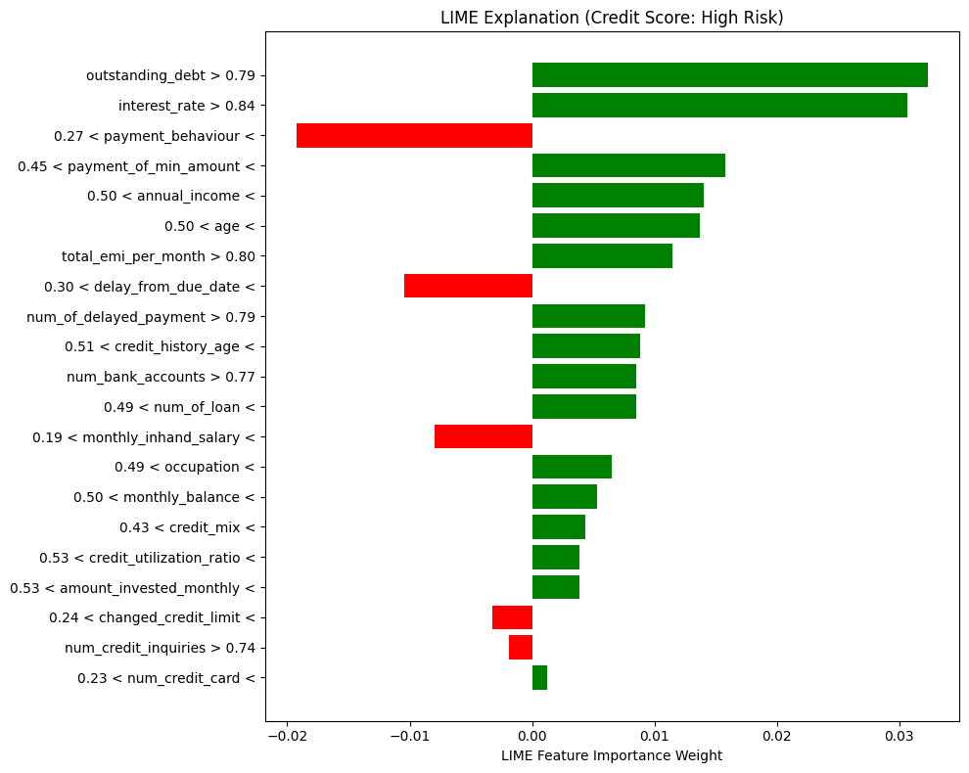
Explainable AI (LIME)

Slide 22
Conclusion
A blockchain by itself secures data through hashing and chaining blocks, but with a Merkle tree, you ensure that even large datasets can be verified with minimal computation.
The Merkle root, which represents the entire batch, can be used to quickly verify all records in the batch without needing to check every record individually.
Machine Learning helps to identify credit score more efficiently.
SHAP and LIME as Explainable AI makes the Blackbox ML models more trustworthy.
In future, explore Federated Learning to train models across institutions without sharing raw data.

